Slide 1
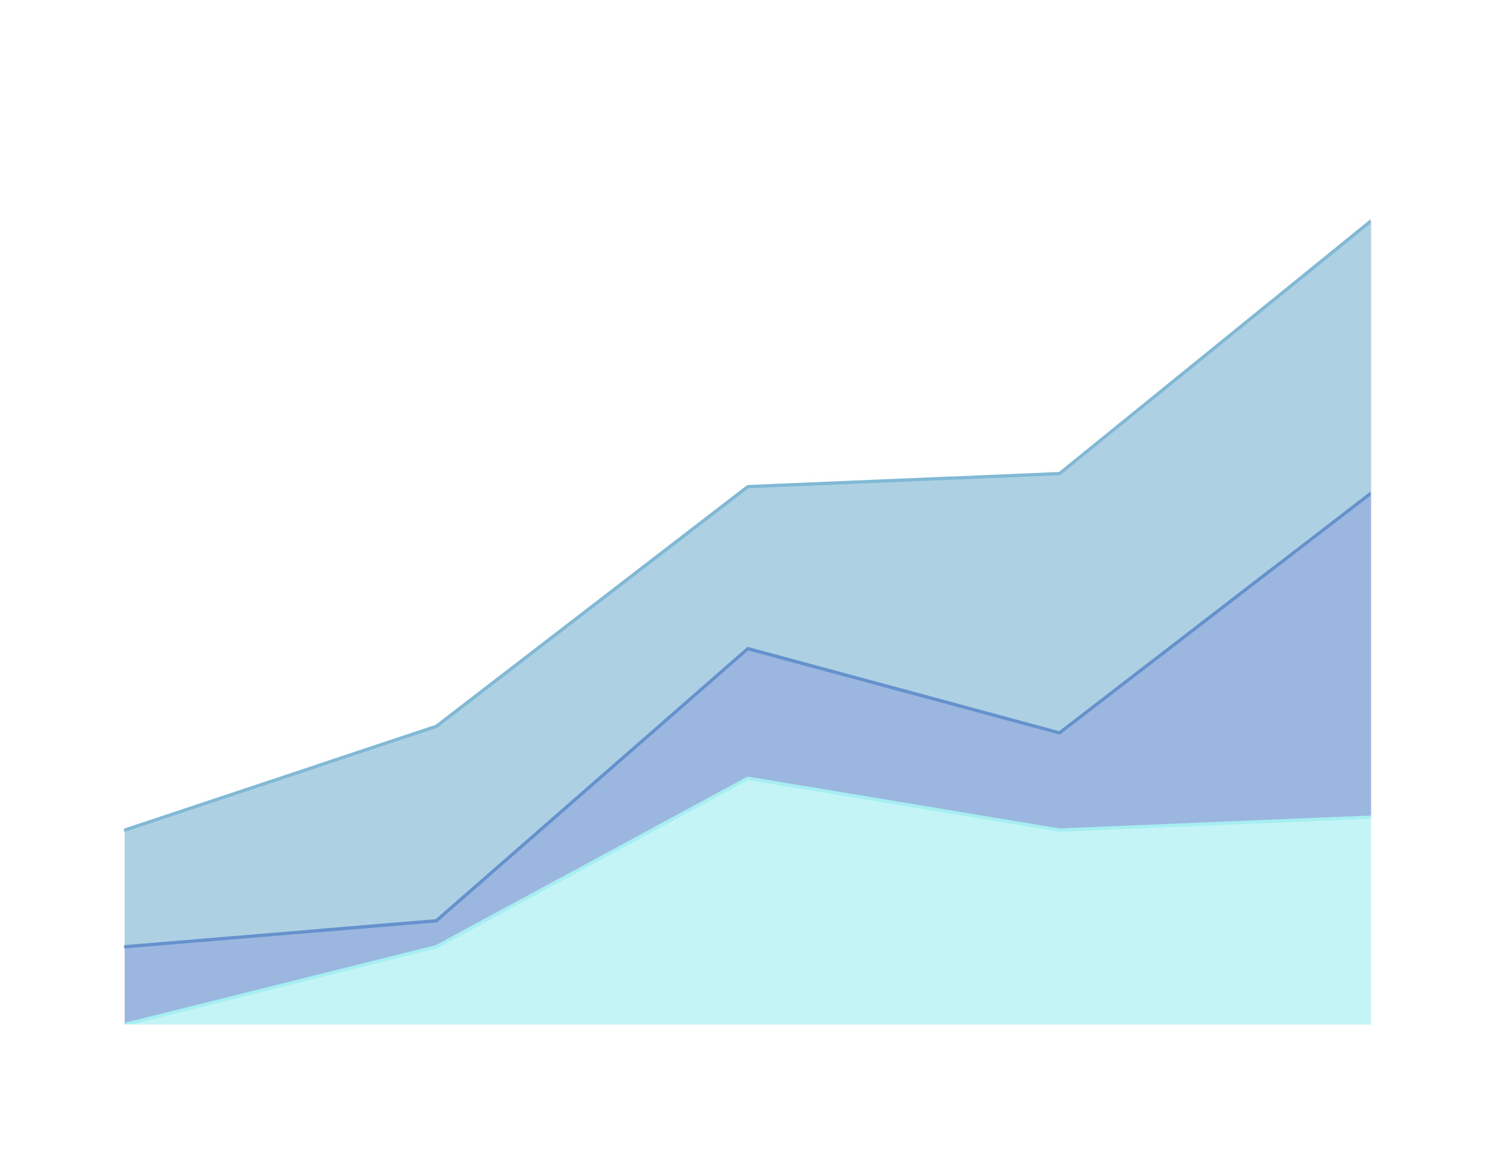
CDS6344 SOCIAL MEDIA COMPUTING
SENTIMENT ANALYSIS AND OPINION MINING OF FIFA 23 STEAM REVIEWS
GROUP 10
Student Name | Student ID
YASER E H ABULABAN | 1221305612
Lai Cal Wyn | 1231303570
TC2L / TT8L
SUBMITTED TO:
DR. HAQUE RADIAH

Slide 2
GROUP MEMBER CONTRIBUTION
Student Name | Student ID | Tasks Completed | Contribution (100%)
Yaser E H Abulaban | 1221305612 | Problem statement and hypotheses dataset cleaning and preprocessing VADER sentiment analysis and binary voted_up comparison traditional ML model evaluation hypothesis testing interpretation report results and discussion support | 50%
Lai Cal Wyn | 1231303570 | Literature review and project background feature engineering and TF-IDF explanation BiLSTM and DistilBERT model discussion opinion mining and ABSA analysis visualization selection conclusion, future work and presentation slide preparation | 50%

Slide 3
PROJECT BACKGROUND
SENTIMENT ANALYSIS CAN AUTOMATE UNDERSTANDING OF PLAYER OPINIONS.
STEAM CONTAINS THOUSANDS OF USER REVIEWS.
MANUAL ANALYSIS IS DIFFICULT AND TIME-CONSUMING.
FIFA 23 REVIEWS IS SELECTED AS A CASE STUDY.

Slide 4

PROBLEM STATEMENT & OBJECTIVES
Problem
Large amount of review data
Difficult to analyze manually
Need automated sentiment classification
Objectives
Build an end-to-end NLP pipeline for FIFA 23 Steam reviews.
Classify recommendation sentiment using the real Steam voted_up label.
Compare VADER, traditional ML, BiLSTM, and DistilBERT.
Perform opinion mining to identify common review phrases.
Apply aspect-based sentiment analysis to game-related issues.
Generate useful insights for player dissatisfaction and improvement areas.

Slide 5

HYPOTHESIS
Hypothesis | Description
H1 | Recent playtime (last 2 weeks) significantly impacts review sentiment.
H2 | The number of games owned influences how critically a player evaluates a title.
H3 | Player sentiments exhibit volatile fluctuations and shifts over time.
H4 | Written sentiment partially agrees with the binary Steam voted_up recommendation label.

Slide 6
1
DATASET
2
PREPROCESSING
3
EXPLORATORY DATA ANALYSIS
OVERALL METHODOLOGY
4
FEATURE EXTRACTION
5
MODEL TRAINING
6
EVALUATION
7
OPINION MINING
8
ASPECT-BASED SENTIMENT ANALYSIS

Slide 7
DATASET OVERVIEW
Dataset Information | Value
Source | Kaggle (https://www.kaggle.com/datasets/noahx1/fifa-23-steam-reviews)
Original Reviews | 25,737
Cleaned Reviews | 20,050
Positive Reviews | 9,310
Negative Reviews | 10,740

Slide 8
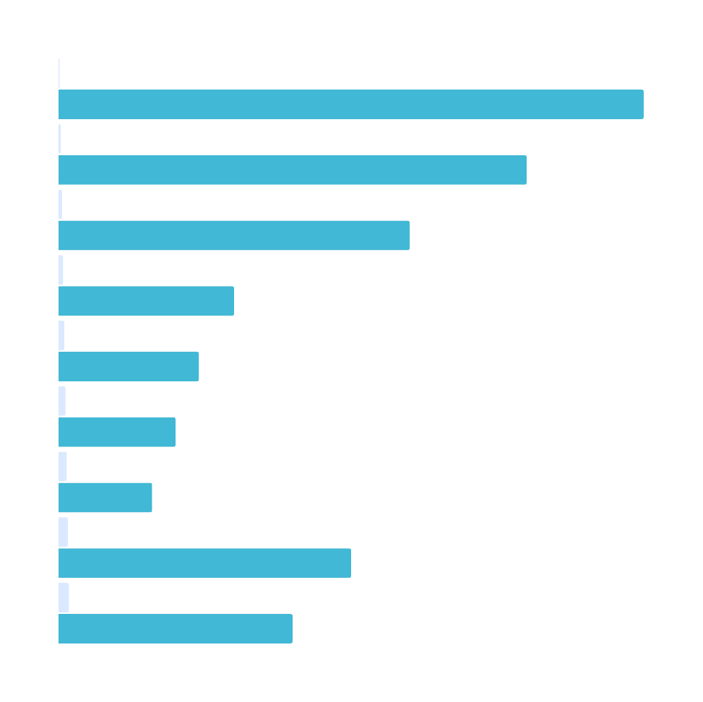
Data Preprocessing
Case Folding: Lowercasing all text to ensure uniformity.
Noise Removal: Eliminating HTML tags, URLs, special characters, and digits.
Tokenization & Stop-word Removal: Splitting sentences into words and stripping low-meaning terms (the, is, and).
Lemmatization: Converting variations of words to their base root forms (example: playing to play).
Deduplication: Dropping duplicate review chains and empty records.

Slide 9
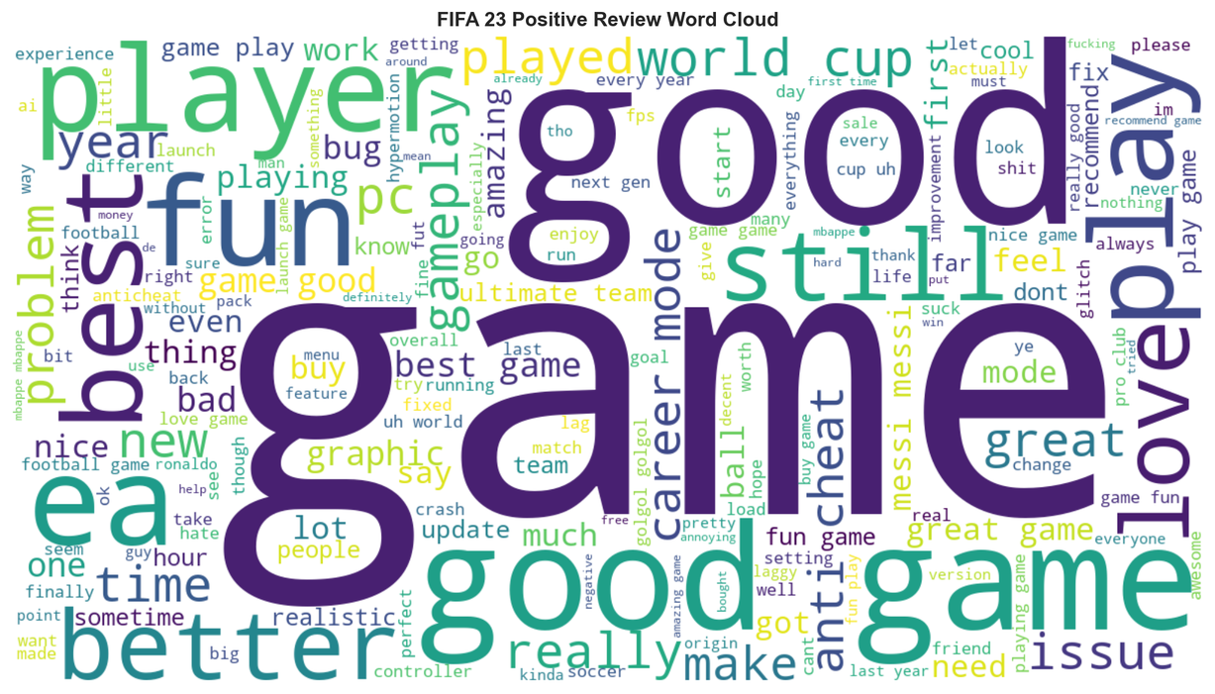
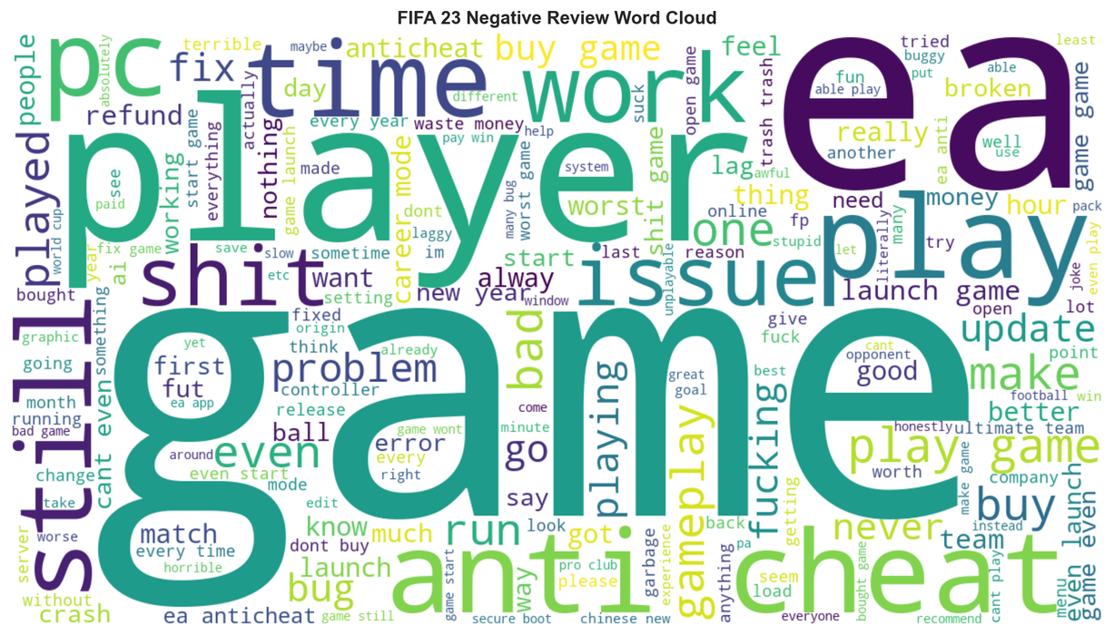
EDA AND TARGET LABELING
Binary classification:
Uses Steam voted_up as the real supervised label.
True = Positive / Recommended
False = Negative / Not Recommended
Multi-class experiment:
Uses VADER-derived weak labels.
Positive: compound score >= 0.05
Neutral: -0.05 < compound score < 0.05
Negative: compound score <= -0.05
Important note:
Multi-class labels are not human ground truth. They are weak labels created from VADER scores.

Slide 10
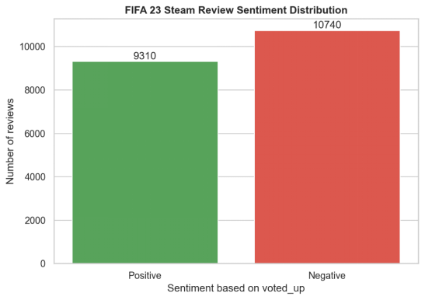
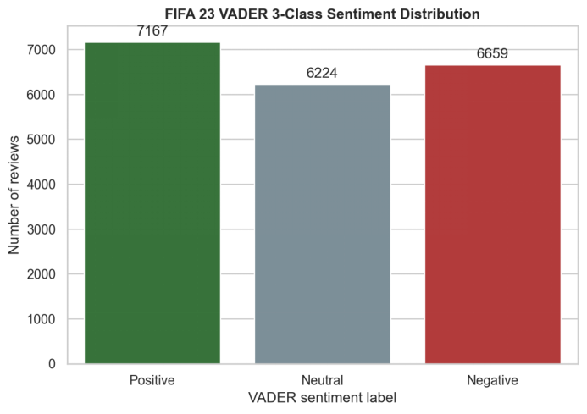
SENTIMENT DISTRIBUTION COMPARISON

Slide 11
FEATURE ENGINEERING & MACHINE LEARNING APPROACHES
ML Models | Explanation
Logistic Regression | Serves as a robust baseline classifier for sparse data.
Linear Support Vector Machine (SVM) | Maximizes decision boundaries in high-dimensional text space.
Random Forest | Ensemble of decision trees checking non-linear token splits.
Multinomial Naïve Bayes | Fast probabilistic baseline tracking conditional text frequencies.
Feature Extraction:
TF-IDF was used for traditional ML models.
TF-IDF gives higher weight to important review terms.
BiLSTM used learned word embeddings.
DistilBERT used contextual embeddings from a pretrained transformer.

Slide 12
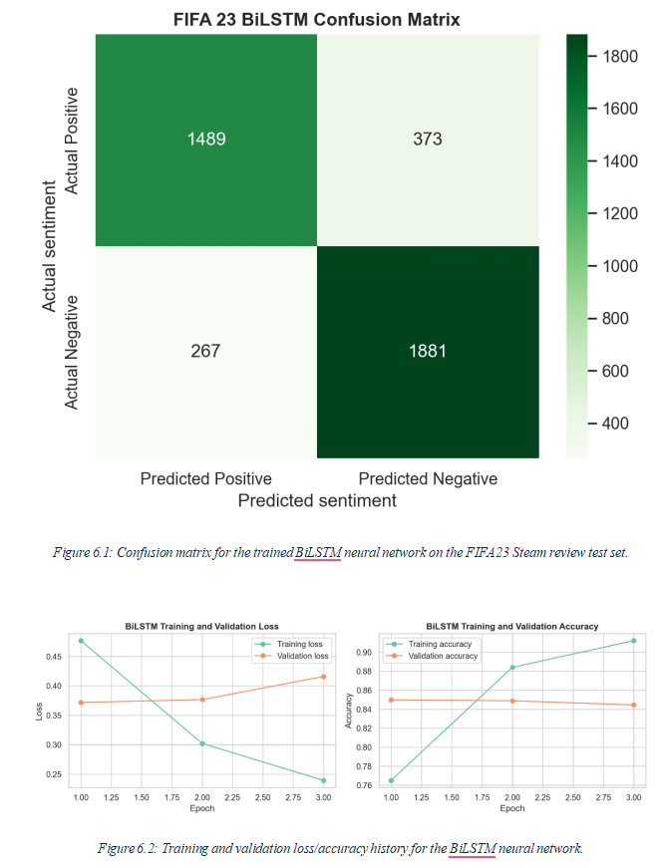
DEEP LEARNING & PRETRAINED TRANSFORMER MODELS
Bidirectional LSTM (BiLSTM):
Built using a dynamic TextVectorization and Dense Word Embedding layer.
Processes reviews bidirectionally to capture past and future contextual token sequences.
Regularized using Dropout layers and early-stopping mechanisms to prevent model overfitting.

Slide 13
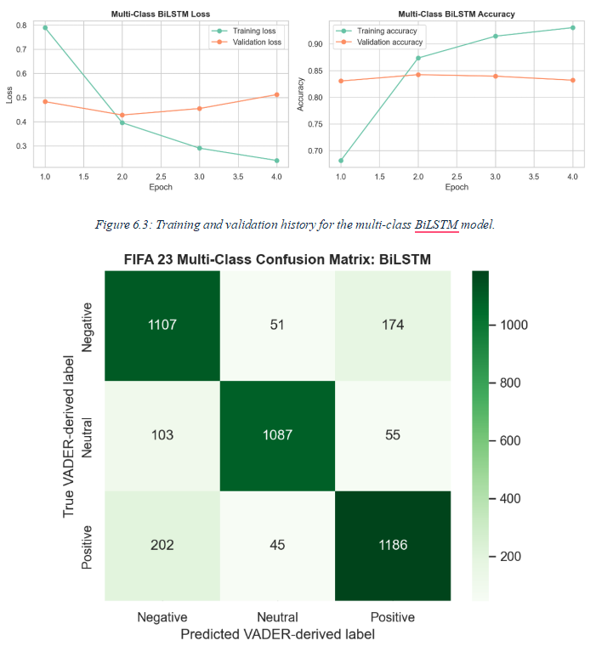
PRETRAINED TRANSFORMER MODELS
DistilBERT (Pretrained Benchmark):
Used as a pretrained transformer benchmark.
Applied through the Hugging Face sentiment pipeline.
Not fine-tuned on FIFA 23 Steam reviews.
Compared against the real Steam voted_up labels.
F1-score = 0.6999
Why performance was lower:
Gaming slang
Sarcasm and short reviews
Mixed opinions
Steam recommendation behaviour differs from sentence-level sentiment

Slide 14
MODEL EVALUATION
Model | Accuracy | Precision | Recall | F1-score
Logistic Regression | 0.8566 | 0.8403 | 0.8534 | 0.8468
Linear SVM | 0.8414 | 0.8193 | 0.8448 | 0.8318
BiLSTM Neural Network | 0.8404 | 0.8479 | 0.7997 | 0.8231
Random Forest | 0.8155 | 0.7802 | 0.8389 | 0.8085
Multinomial Naive Bayes | 0.7793 | 0.8621 | 0.6246 | 0.7244
Transformer DistilBERT SST-2 | 0.7565 | 0.8184 | 0.6114 | 0.6999

Slide 15
HYPOTHESIS VERIFICATION
Hypothesis | Test | Main Result | Interpretation
H1: Higher recent playtime relates to positive reviews | Mann-Whitney U | p = 5.921e-121; positive median = 5.07 hours; negative median = 0.32 hours | Supported
H2: More games owned relates to negative reviews | Mann-Whitney U | p = 7.634e-187; positive median = 16; negative median = 30 | Supported
H3: Sentiment changes over time | Chi-square | p=7.256e-43; sentiment distribution changes significantly over time. | Supported
H4: Written sentiment partially agrees with voted_up | VADER agreement | VADER binary sentiment partially agrees with voted_up for 69.36% of cleaned reviews. Mismatches may indicate sarcasm, slang, short text, or mixed opinions. | Partially supported

Slide 16
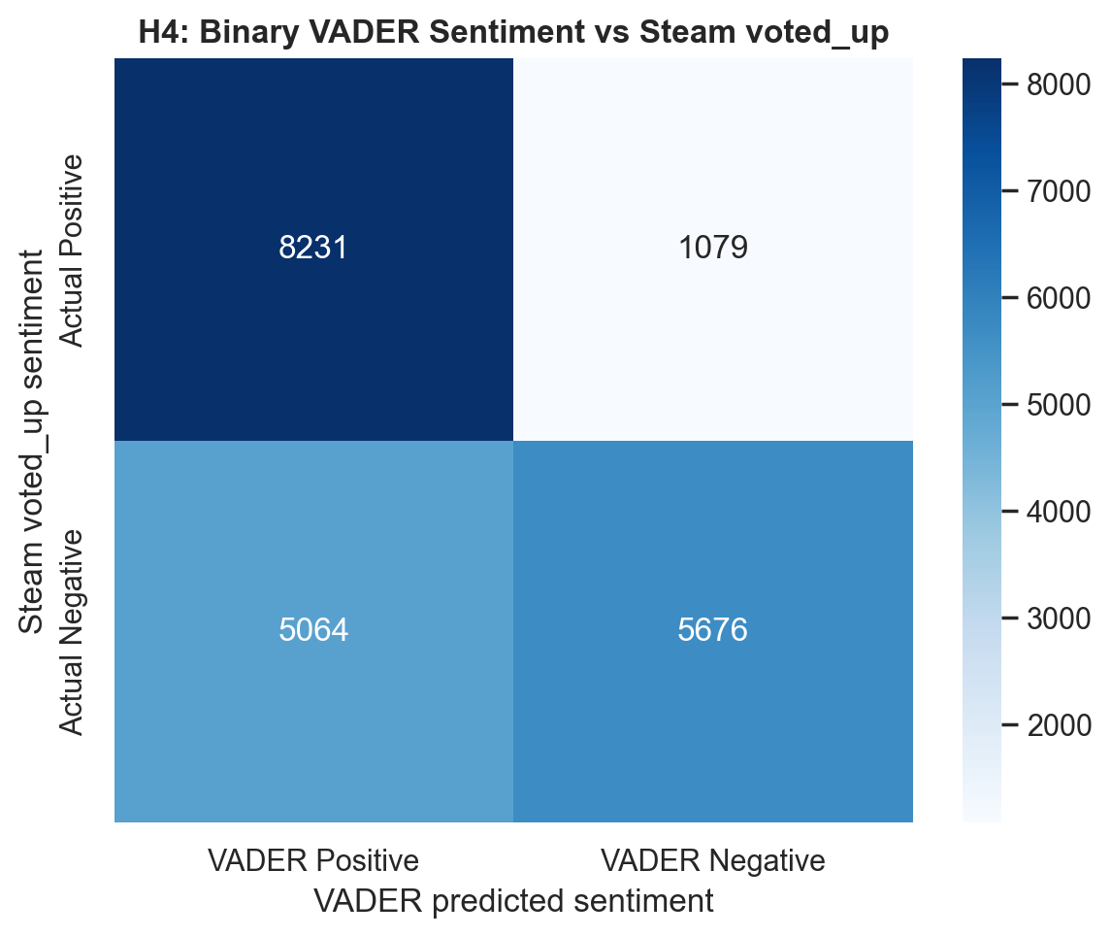
VADER BASELINE & AGREEMENT
VADER was used as the lexicon-based sentiment baseline.
It gives a compound sentiment score for each review.
For H4, VADER was converted into binary sentiment:
compound >= 0 = Positive
compound < 0 = Negative
Binary VADER agreement with Steam voted_up: 69.36%
This means written sentiment and Steam recommendation are related, but not identical.

Slide 17
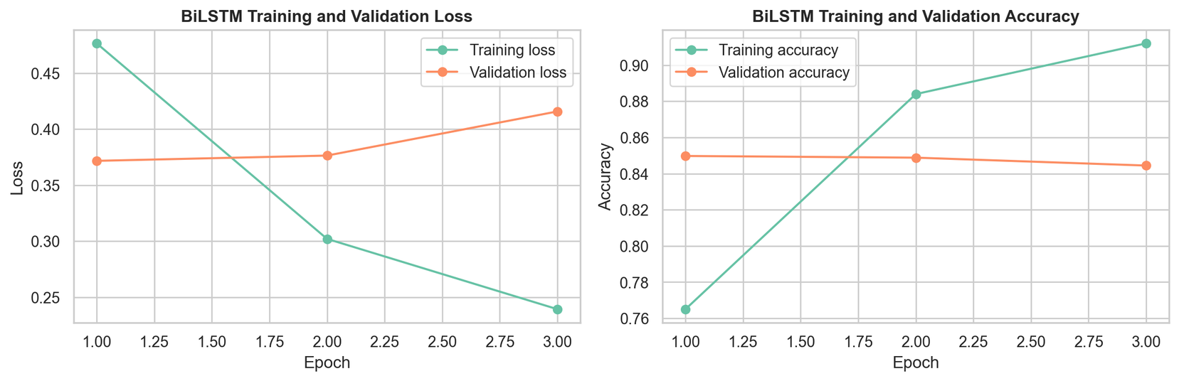
CROSS-VALIDATION & OVERFITTING CHECK
Model | Mean CV F1-Score | Standard Deviation
Logistic Regression | 0.8402 | 0.0062
Linear SVM | 0.8356 | 0.0046
Multinomial Naive Bayes | 0.7087 | 0.0105
5-fold stratified cross-validation:
Logistic Regression mean CV F1 = 0.8402
Linear SVM mean CV F1 = 0.8356
Naive Bayes mean CV F1 = 0.7087
Model reliability:
Low standard deviations show stable performance.
BiLSTM used dropout and early stopping.
SMOTE was not used because class imbalance was moderate.
Grid Search was not used; fixed hyperparameters were used to keep Colab runtime manageable.

Slide 18
ASPECT-BASED SENTIMENT ANALYSIS
Aspect | Total Mentions | Positive % | Negative %
Gameplay | 2,197 | 33.96% | 66.04%
Graphics | 752 | 56.25% | 43.75%
Performance/Bugs | 2,241 | 19.95% | 80.05%
Servers/Online | 721 | 16.78% | 83.22%
Career/Content | 1,769 | 35.56% | 64.44%
Price/Monetization | 4,207 | 15.78% | 84.22%
Main negative aspects:
Price/Monetization: 84.22% negative
Servers/Online: 83.22% negative
Performance/Bugs: 80.05% negative
Most positive aspect:
Graphics: 56.25% positive

Slide 19
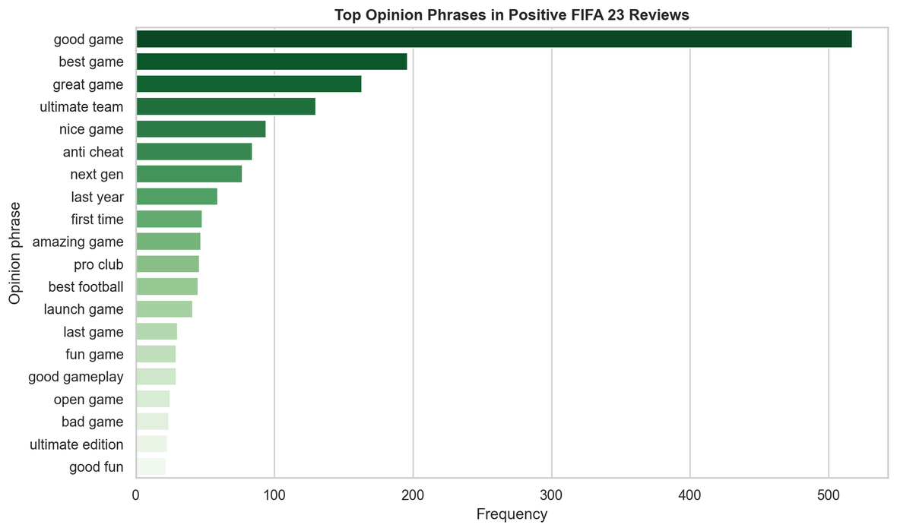
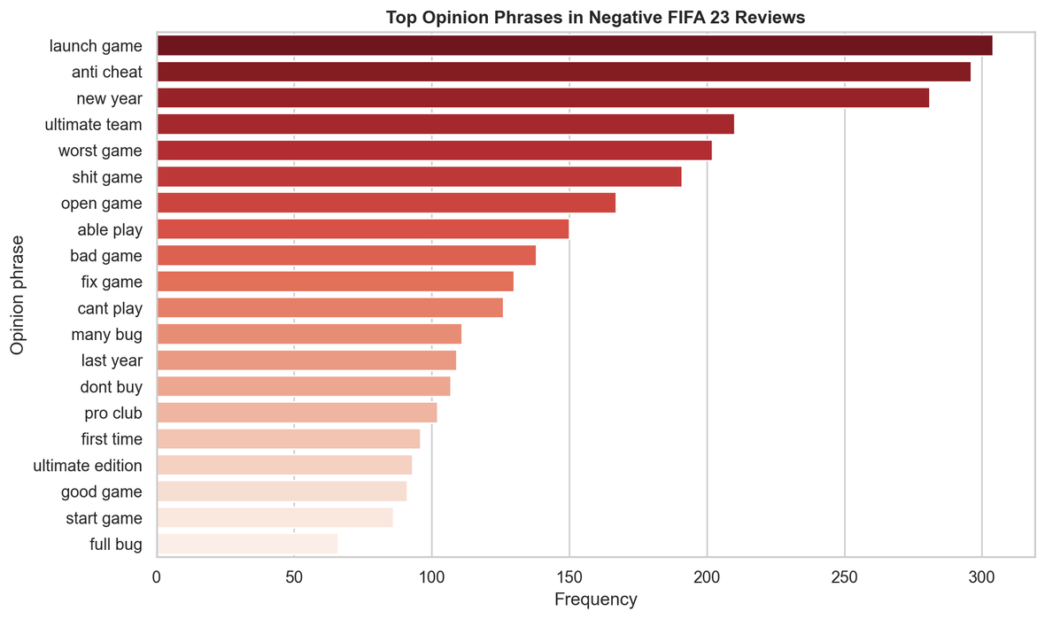
OPINION MINING RESULTS
Positive opinion phrases:
good game
best game
great game
ultimate team
next gen
Negative opinion phrases:
launch game
anti cheat
worst game
bad game
fix game
cant play
Positive reviews focus on enjoyment and game modes. Negative reviews focus more on launch issues, anti-cheat, bugs, and playability problems.

Slide 20
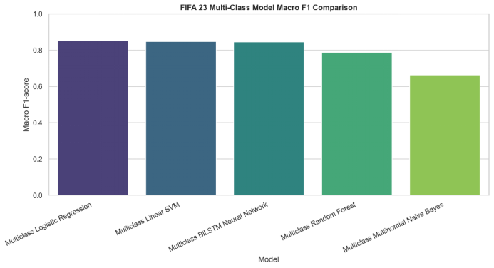
MULTI-CLASS SENTIMENT CLASSIFICATION RESULTS USING VADER-DERIVED WEAK LABELS.
Model | Accuracy | Macro F1 | Weighted F1
Logistic Regression | 0.8511 | 0.8511 | 0.8503
Linear SVM | 0.8474 | 0.8473 | 0.8463
BiLSTM Neural Network | 0.8429 | 0.8450 | 0.8436
Random Forest | 0.7890 | 0.7883 | 0.7872
Multinomial Naive Bayes | 0.6845 | 0.6630 | 0.6670
Logistic Regression achieved the best multi-class Macro F1-score = 0.8511. BiLSTM was close with Macro F1-score = 0.8450.
These are VADER-derived weak labels, not manually annotated human sentiment labels.

Slide 21

KEY INSIGHTS & RECOMMENDATIONS
Key Insights
FIFA 23 feedback was mixed, but leaned negative.
Logistic Regression was the best binary model.
BiLSTM performed well as the trained deep learning model.
DistilBERT underperformed because it was not fine-tuned.
VADER only partially agreed with voted_up.
Recommendations:
Improve price/value perception.
Reduce monetization frustration.
Fix bugs, crashes and anti-cheat issues.
Improve online server stability.
Maintain graphics quality because it was the most positive aspect.

Slide 22
CONCLUSION
FUTURE WORK
FIFA 23 Steam reviews were mixed but leaned negative.
Logistic Regression with TF-IDF gave the best binary result.
BiLSTM worked well as a trained deep learning model.
DistilBERT was useful as a transformer benchmark, but was not fine-tuned.
Main dissatisfaction came from monetization, servers, bugs, and performance.
Graphics was the strongest positive aspect.
Manually annotate Positive, Neutral, and Negative sentiment labels.
Fine-tune DistilBERT or another transformer on FIFA 23 reviews.
Improve BiLSTM through tuning and pretrained embeddings.
Expand aspect dictionaries with more football and EA-specific terms.
Compare FIFA 23 with other EA Sports FC / FIFA releases.

